Slide 2
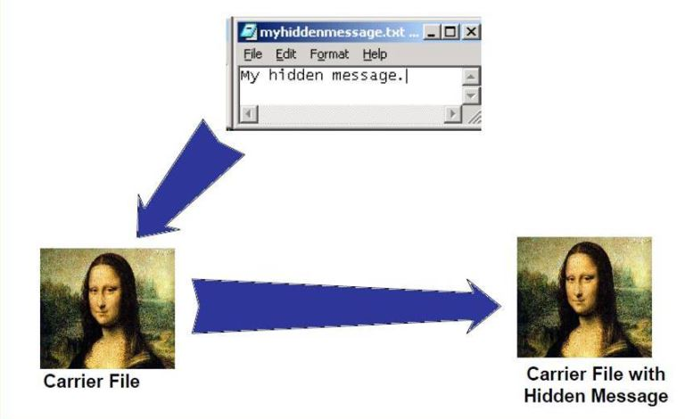
Steganography
Steganography is the process of hiding secret data within an ordinary, non-secret, file or message in order to avoid detection.

Slide 3
Types of steganography

Slide 4
Steganography(Cont. )
Terminology
Carrier or cover file - A original message or file in which hidden information will be stored inside of it
Stego-medium –The medium which the information transferred
Embedded – The information which is to be hidden
Stegokey – An additional piece of information, such as a password or mathemeticalvariable, required to embed the secret information
Steganalysis – The process of detecting hidden information inside a file

Slide 5
Motivation

Slide 6
Applications
Confidential Communication
Secret Data Storing
Ensuring Secret Data’s Protection

Slide 7
Importance
Personal and private data
Sensitive data
Confidential data and trade secrets
To avoid misuse of data
Unintentional damage to data , human error and accidental detection of data

Slide 8
Related Works

Slide 9
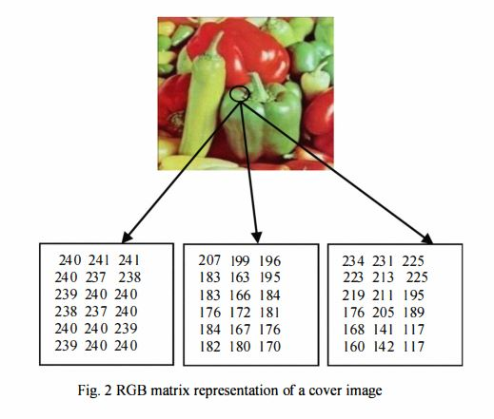
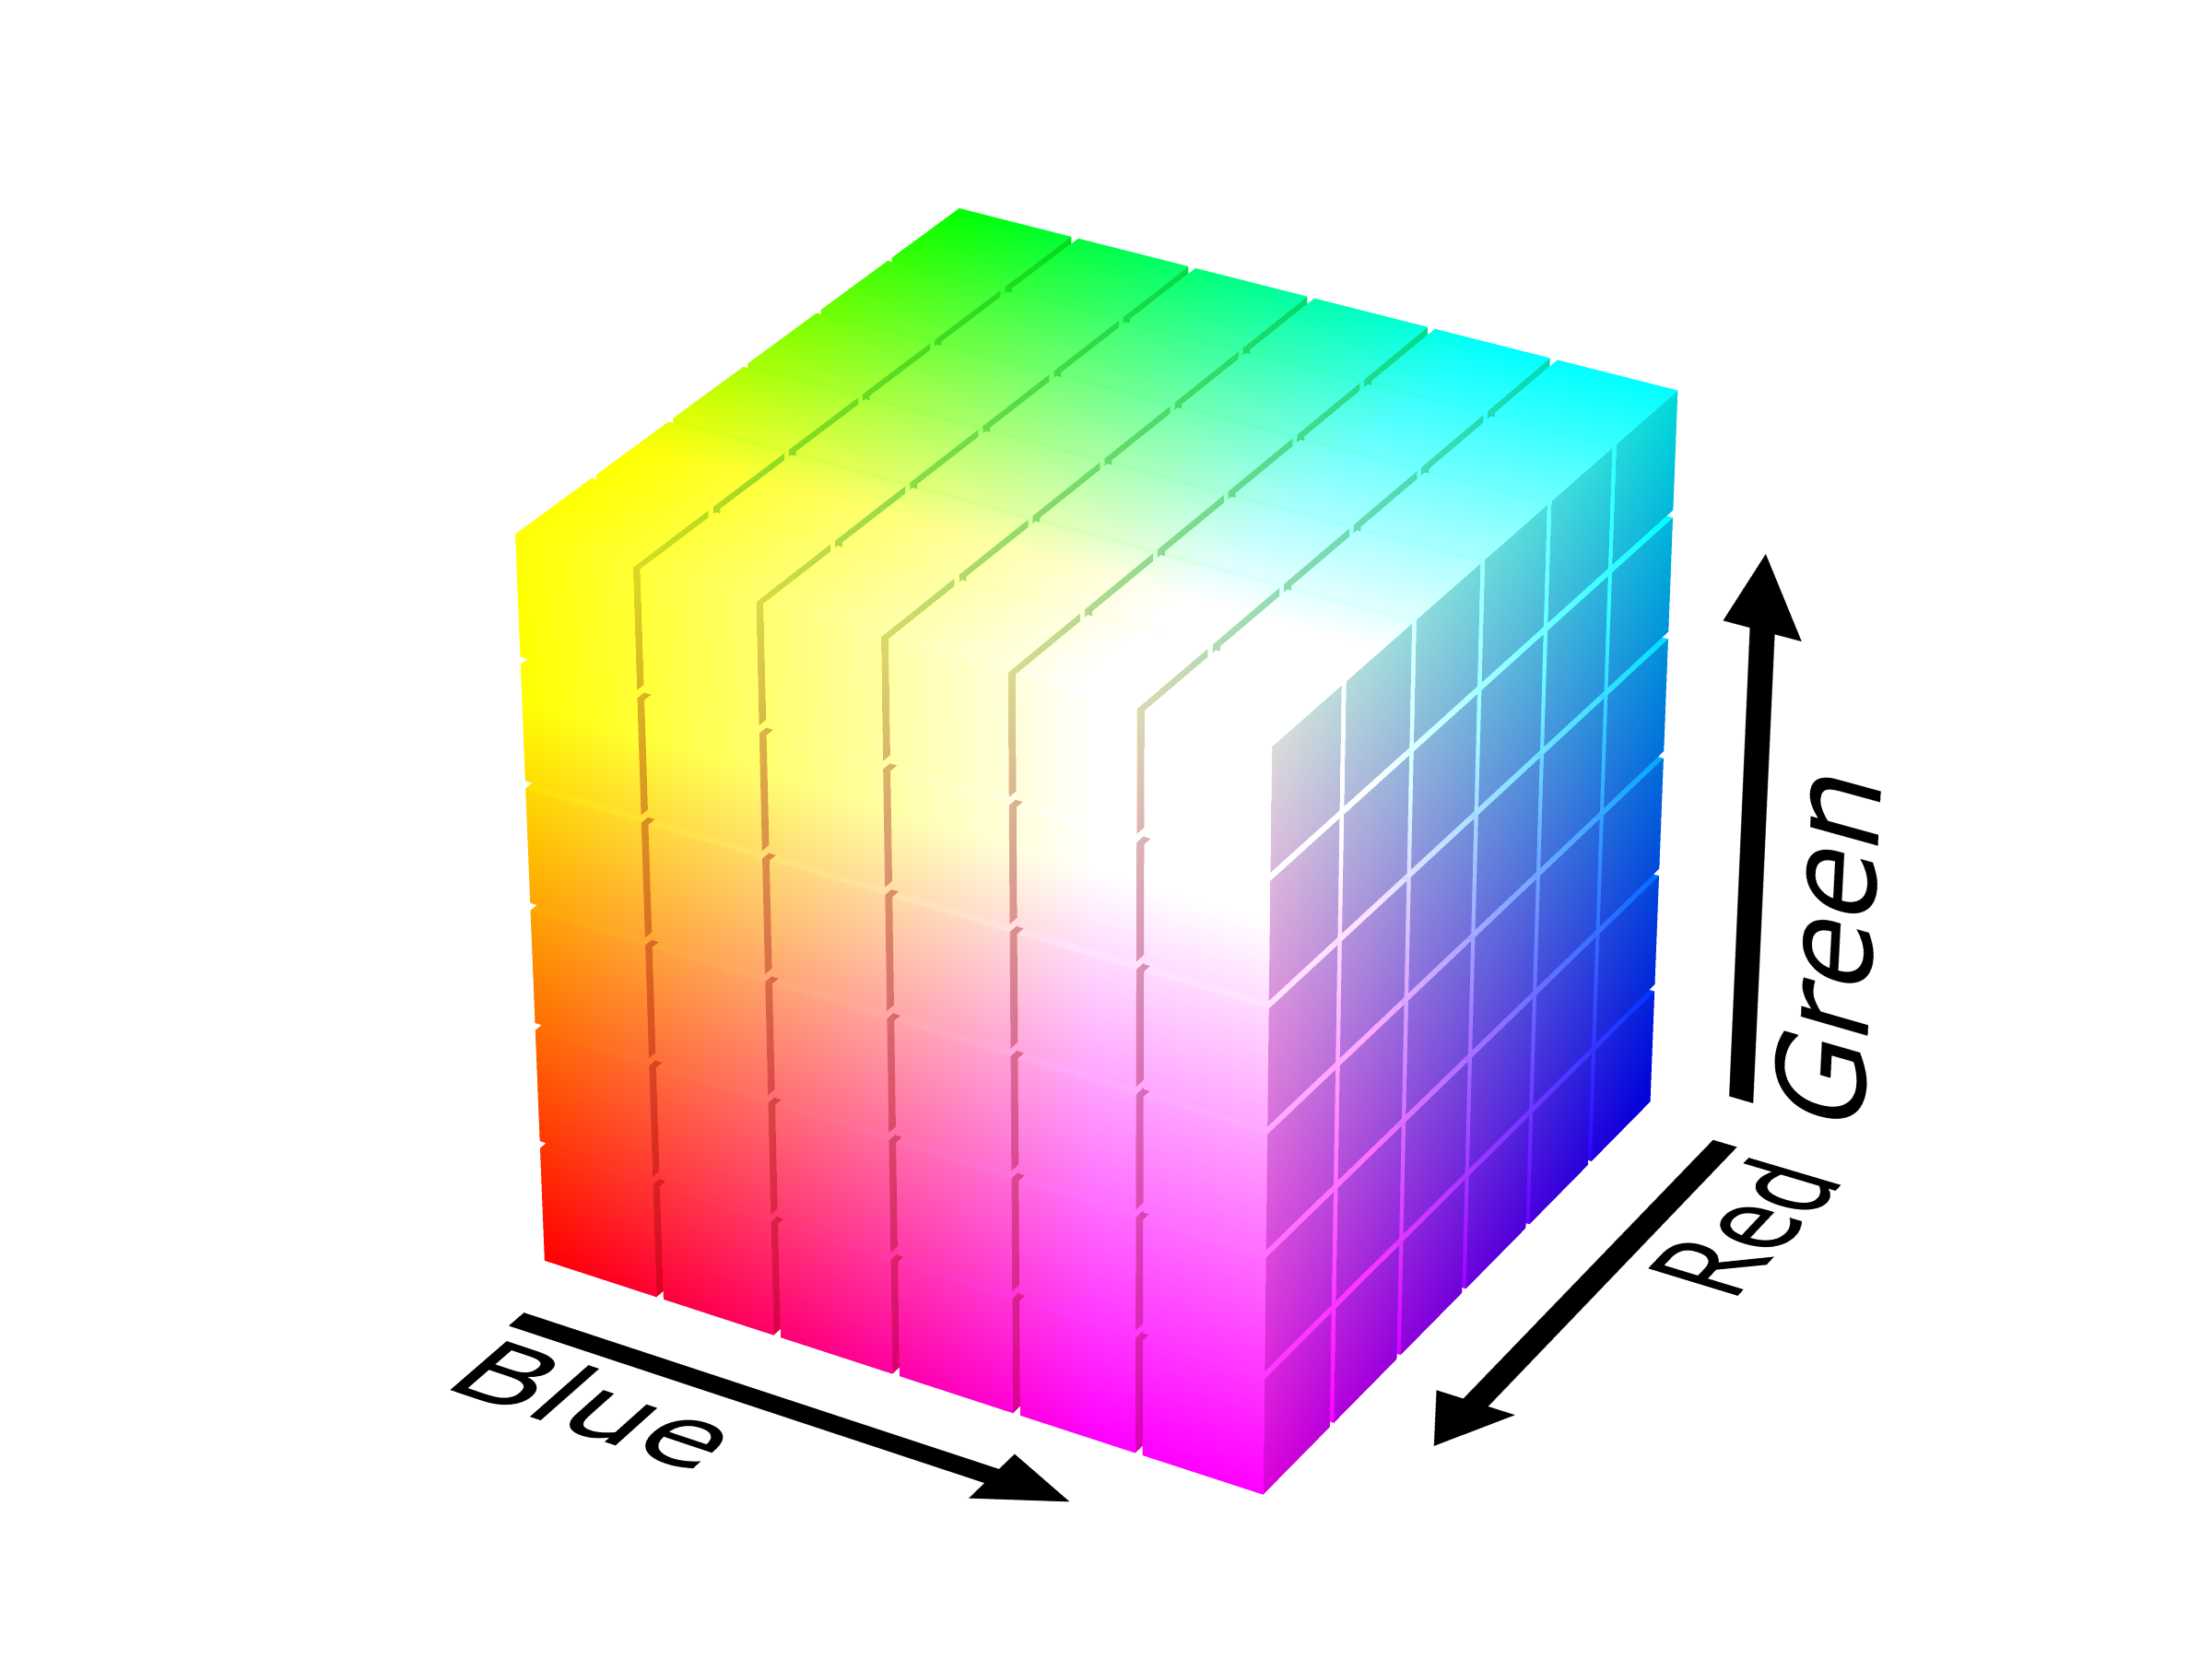
RGB
The RGB color model is an additive color model in which red, green and blue light are added together in various ways to reproduce a broad array of colors.

Slide 10
LSB Method
LSB-Steganography is a steganography technique in which we hide messages inside an image by replacing Least significant bit of image with the bits of message to be hidden

Slide 11
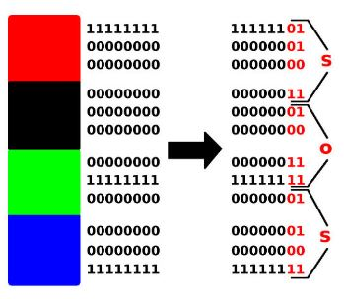

LSB Method(Cont. )

Slide 12
Analysis of Tools

Slide 13
Basic Implement

Slide 14

HASHING
What is hashing??
Hashing is the transformation of a string of characters into a usually shorter fixed-length value or key that represents the original string. Hashing is used to index and retrieve items in a database because it is faster to find the item using the shorter hashed key than to find it using the original value. It is also used in many encryption algorithms.
Function:-
Use to map data of arbitrary size to data of fixed size
Provide Strong Security
Every hash value is unique and it is one way technique
It serves as a checksum
Each hashing algorithm outputs at a fixed length

Slide 15
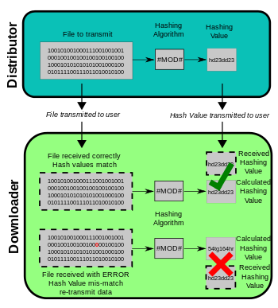
HASHING ALGORITHM
MD5 - MD5 is the most widely known hashing function. It produces a 16-byte hash value, usually expressed as a 32 digit hexadecimal number. Recently a few vulnerabilities have been discovered in MD5, and rainbow tables have been published which allow people to reverse MD5 hashes made without good salts.

Slide 16

CRYPTOGRAPHY
Oxford Dictionary defines cryptography as the art of writing and solving codes.
Cryptography is the most often associated with scrambling plaintext into ciphertext, then back again ciphertext (known as decryption).

Slide 17
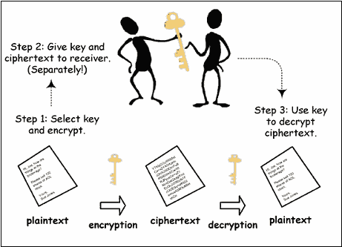
GENERAL PROCESS

Slide 18
SECRET KEY
A secret key is the piece of information or parameter that is used to encrypt and decrypt messages in a symmetric, or secret-key, encryption.
In asymmetric encryption, two separate keys are used. One is a public key and the other is a secret key. A secret key may also be known as a private key.

Slide 19
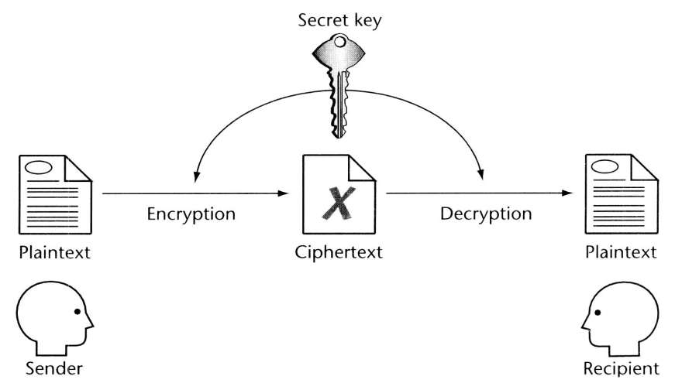
GENERAL PROCESS

Slide 20
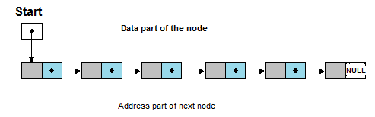
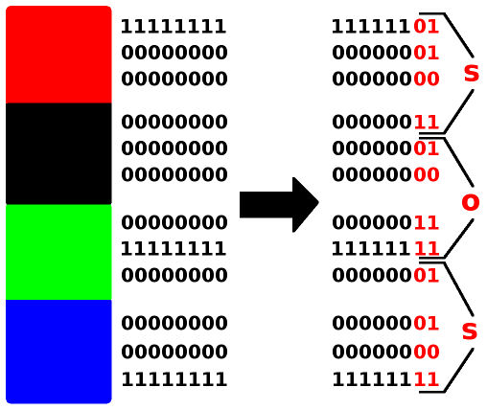
ROBUST STEGANOGRAPHY
In future we will make a Robust Steganography tool that have some extra properties like Link list with LSB technique, Cryptography and Hashing.

Slide 21
DEEP LEARNING
Our goal is to develop a tool that can detect if any information is hidden into the image and this detection will be done by using deep learning method
INPUT
IMAGE
OUTPUT
DETECTS STEGANOGRAPHY

Slide 22
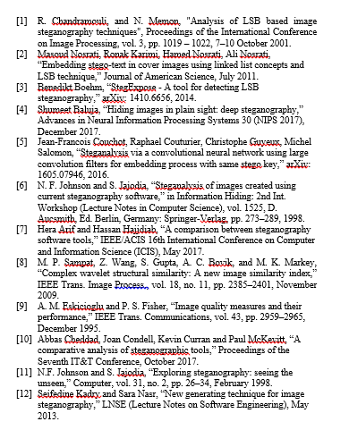
REFERENCE

Slide 23
CONCLUSION

